Slide 1
TrueTouch
Midway Design Review
Team 19

Slide 2
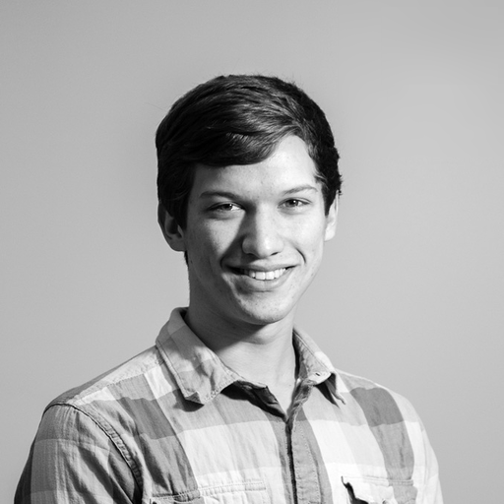
Our Team
Anthony Chan: EE
Alex Dickopf: CSE
Cameron Kluza: CSE
Jonathan Yip: CSE
Notes:
Alex

Slide 3
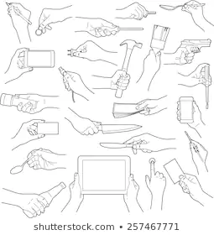
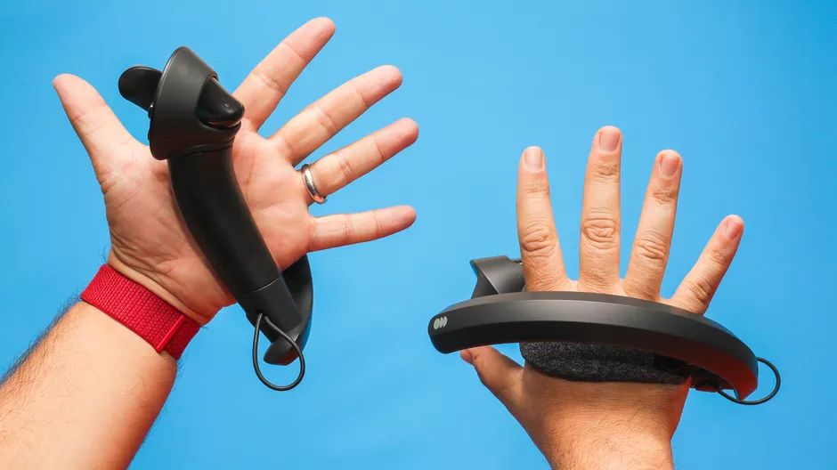
Problem Statement
VR lacks sensation of physical touch
Not realistic if your fingers can go through an object
Hand held controllers
Hand locked in a specific shape
Limited vibration areas
Improvement of immersion
Notes:
Highlight key aspects of problem statement
Alex
-lets review: our project focuses on vr
-while already immersive, it lacks immersion for touch
-we have controllers, but either limit or do not provide proper immersion
-begs the q: how to improve

Slide 4
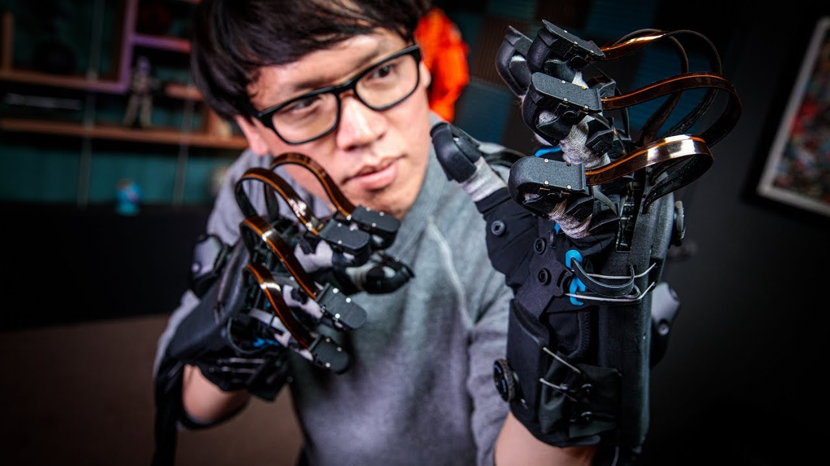
Haptic Feedback
Feedback to simulate physical touch
Different kinds of feedback
...such as force, vibrotactile, ...
Sense of impact and vibration
vibration motors (ERM, LRA, etc)
Sense of shape
Exoskeletons
Notes:
Note that most things on the market only provide vibration feedback
Mostly research and “upcoming” products for feeling shape
Very few solutions that do both
Alex
-answer: hf tech
-different kinds
-
Explain types of feedback when speaking about this slide

Slide 5
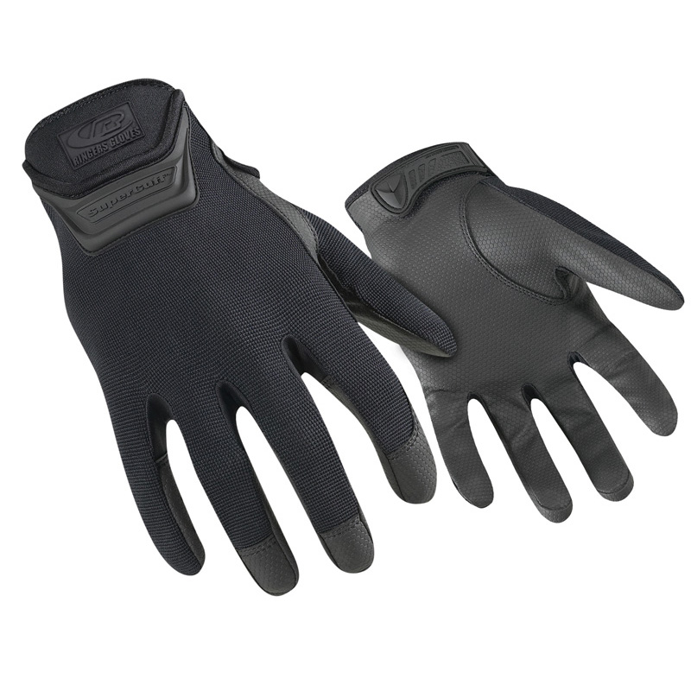
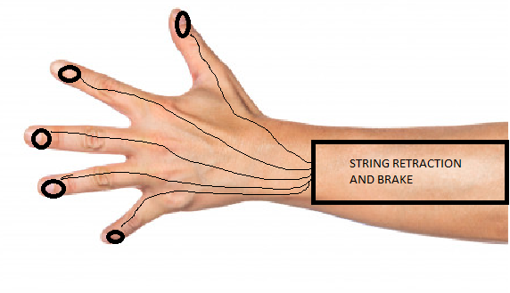
Proposed Solution: TrueTouch
Combining both: feeling of shape and impact
Controller free
Lightweight glove, extending onto the arm
Integrate with Vive Hand Tracking SDK
Ringer R507-09 Duty Gloves
Notes:
Jonathan
Just to remind you of our proposed solution, we wanted to make a lightweight glove device that would provide the feeling of shape and impact. Our design consists of a glove with ERM motors and a forearm mount which houses the ratchet and pawl system. And there are strings running from the forearm mount to the fingers

Slide 6
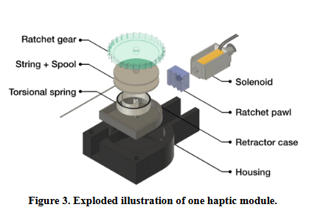
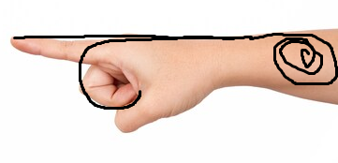
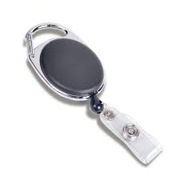
TrueTouch’s “Braking System”
System is mounted on the top of the forearm
Retractable string attached to the back of each fingertip
Length of the string attached to the back of the fingertips vary as you bend your finger
Limiting the length of a string along the back of your finger will limit how far you can bend
Using five ratchet and pawls to lock string length (inspired by Wireality)
Notes:
Jonathan
The first feeling we planned to provide is shape. As you may remember, we planned on using a string to restrict a finger’s movement. This is based on the fact the length from a fixed point on your wrist to the tip of your finger will vary depending on how much you bend your finger. So if your finger is bent, the length from the wrist to your finger will be at its longest. Conversely, if your finger is extended, the length will be at its shortest. We restrict the length of string using a ratchet and pawl system.
The design of the ratchet and pawl system will be explained later.

Slide 7
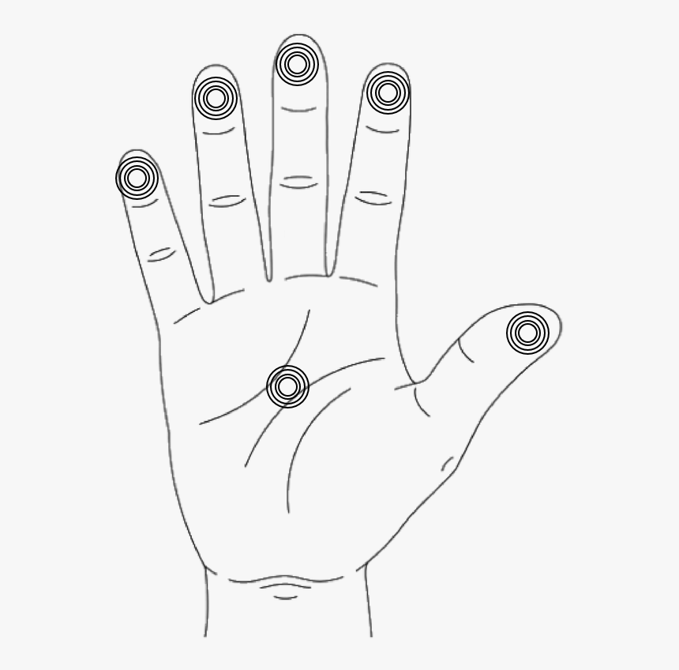
TrueTouch’s Vibrotactile System
Small Eccentric Rotating Mass (ERM) motors will provide vibrations, simulating impact
ERM motors will be placed on palm and each finger to provide sensation of impact against hand
Notes:
Jonathan
To provide the feeling of impact, we placed erm motors on each finger and one the palm. These ERM motors vibrate at different intensities to give a wider range of impacts.

Slide 8
Requirements
Wireless system
Rechargeable battery of minimum 1 hour of life
Single glove with system weighs no more than 2lbs
Braking system and vibration activates within 100ms of seeing the object being touched in virtual world
Braking system able to withstand 20N of pulling force from finger-bending strength
Notes:
Jonathan
To quickly run through the requirements, we wanted the system to be wireless. Because the system is wireless, we need a battery. We want the whole system to be lightweight so no more than 2 lbs. We want the braking system and erm motors to be able to activate within 100ms of interacting with an object in the Virtual world. The last bullet is so our design does not break under aggressive use. So if the user pulls on the string very hard, the physical structure of the device will not be compromised.

Slide 9
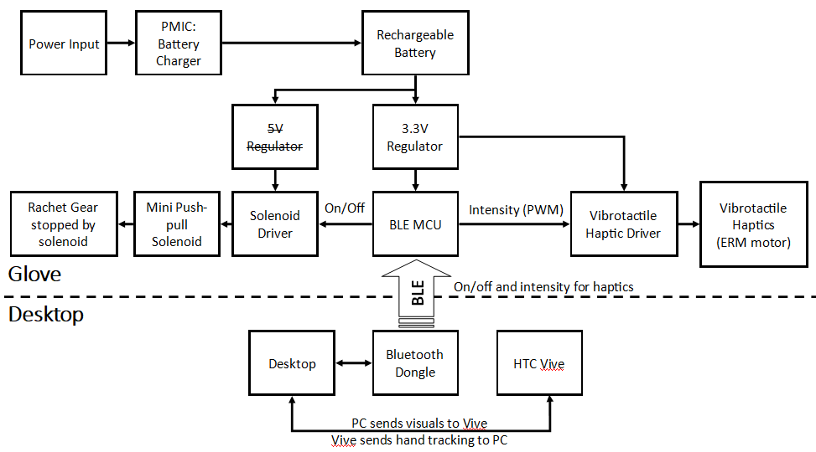
Hardware Block Diagram
Notes:
Cameron
Minor updates
Solenoids drive fine off of battery’s 3.3-4.2V, don’t need a regulator
Not a lot of other stuff has changed

Slide 10
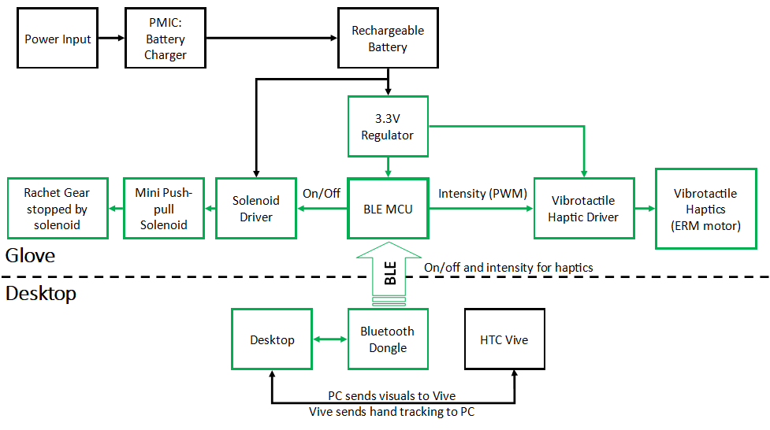
Hardware Block Diagram (completed)
Notes:
Cameron
What we’ve integrated into prototype is highlighted in green

Slide 11
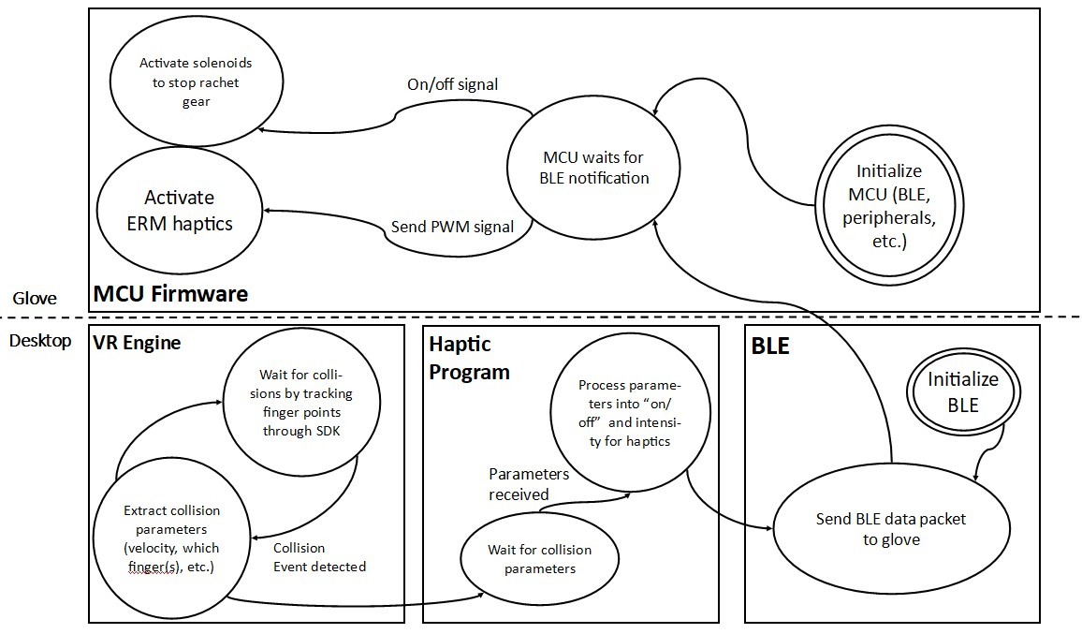
Software Block Diagram
Notes:
Cameron
Anticipating no major changes

Slide 12
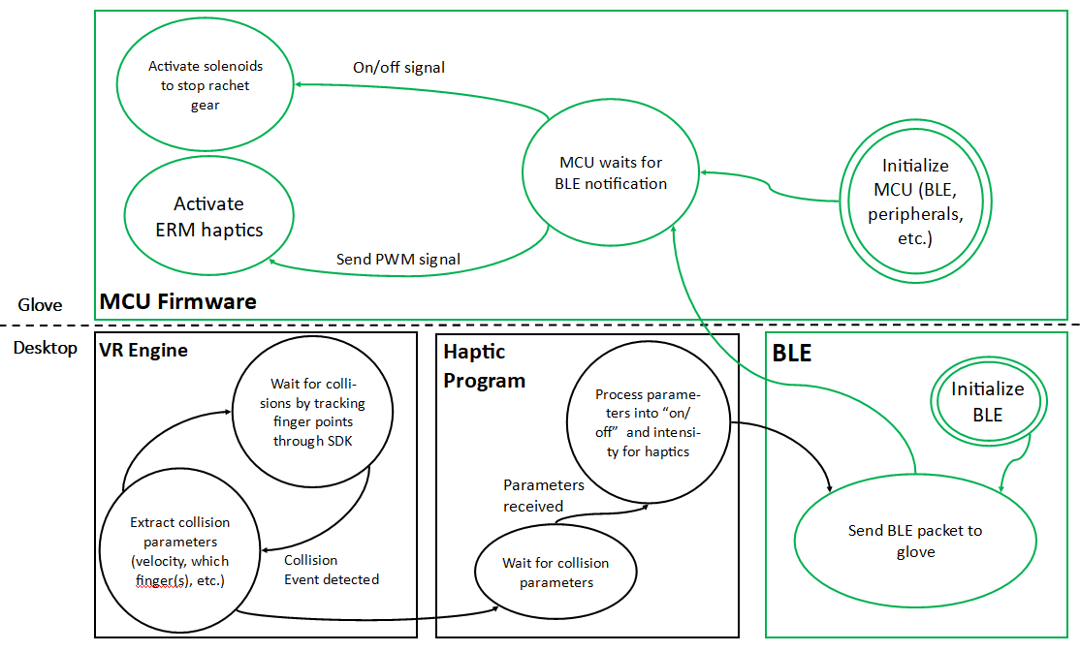
Software Block Diagram (completed)
Notes:
Cameron
We’ve got green implemented

Slide 13
MDR Deliverables
Single glove with implemented braking system and vibrotactile system
Don’t have access to VR headset immediately
Focus on hardware component; less on syncing VR visuals
Microcontroller interfaced with BLE and power systems
Windows BLE program to communicate w/ MCU
Power supply will be wired (micro-USB to MCU); wireless supply to be implemented for FPR
Control vibration and braking system on individual fingers through computer using “dummy data”
Different intensities and movement threshold of finger
Notes:
Anthony

Slide 14
MDR Accomplishments
Single glove with implemented braking system and vibrotactile system
Don’t have access to VR headset immediately
Focus on hardware component; less on syncing VR visuals
Microcontroller interfaced with BLE and power systems
Windows BLE program to communicate w/ MCU
Power supply will be wired (micro-USB to MCU); wireless supply to be implemented for FPR
Control vibration and braking system on individual fingers through computer using “dummy data”
Different intensities and movement threshold of finger
Notes:
Anthony

Slide 15
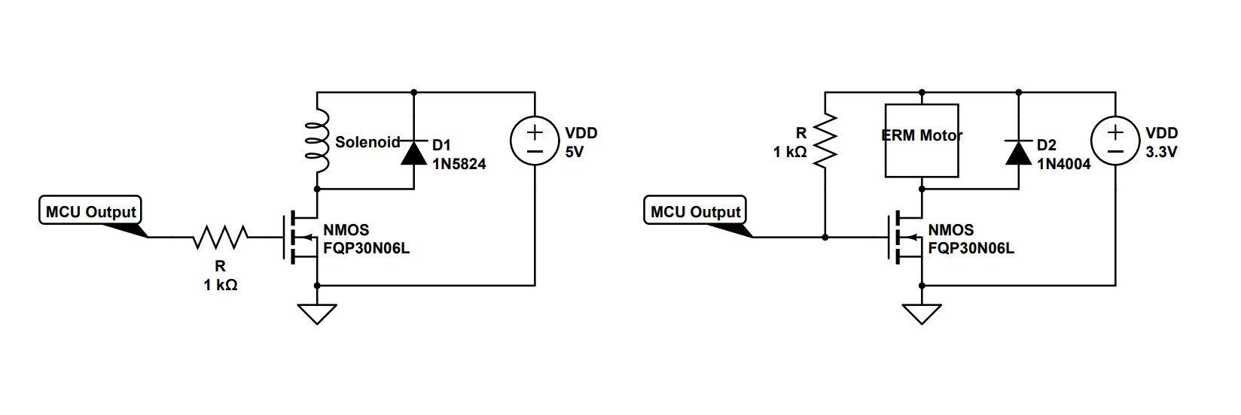
Anthony Chan: Circuit Design
Notes:
Anthony

Slide 16
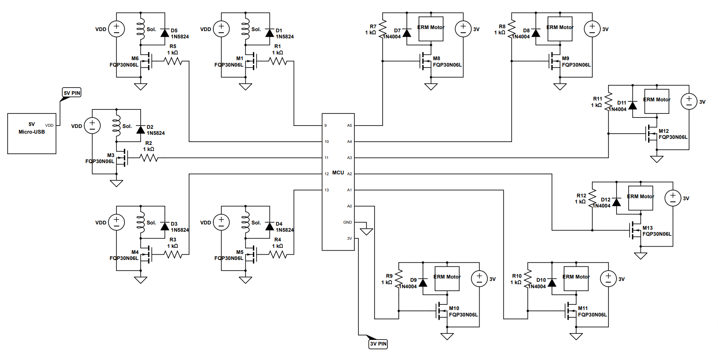
16
Notes:
Anthony

Slide 17
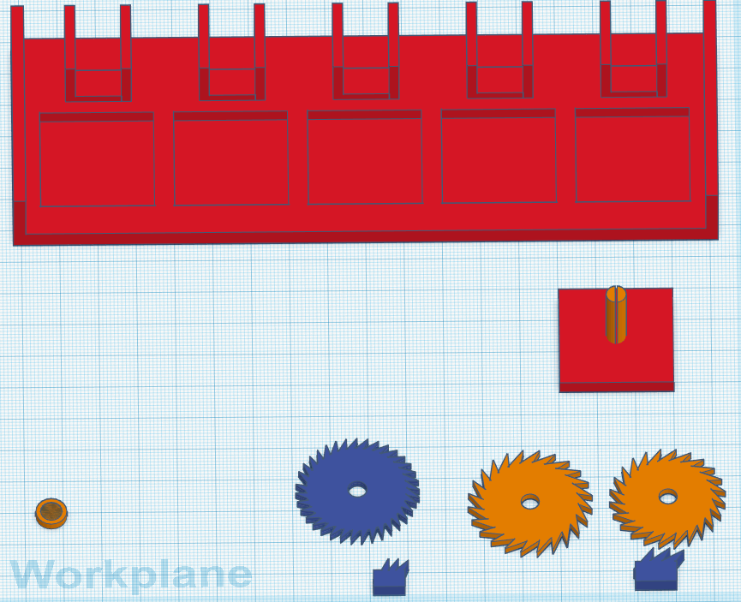
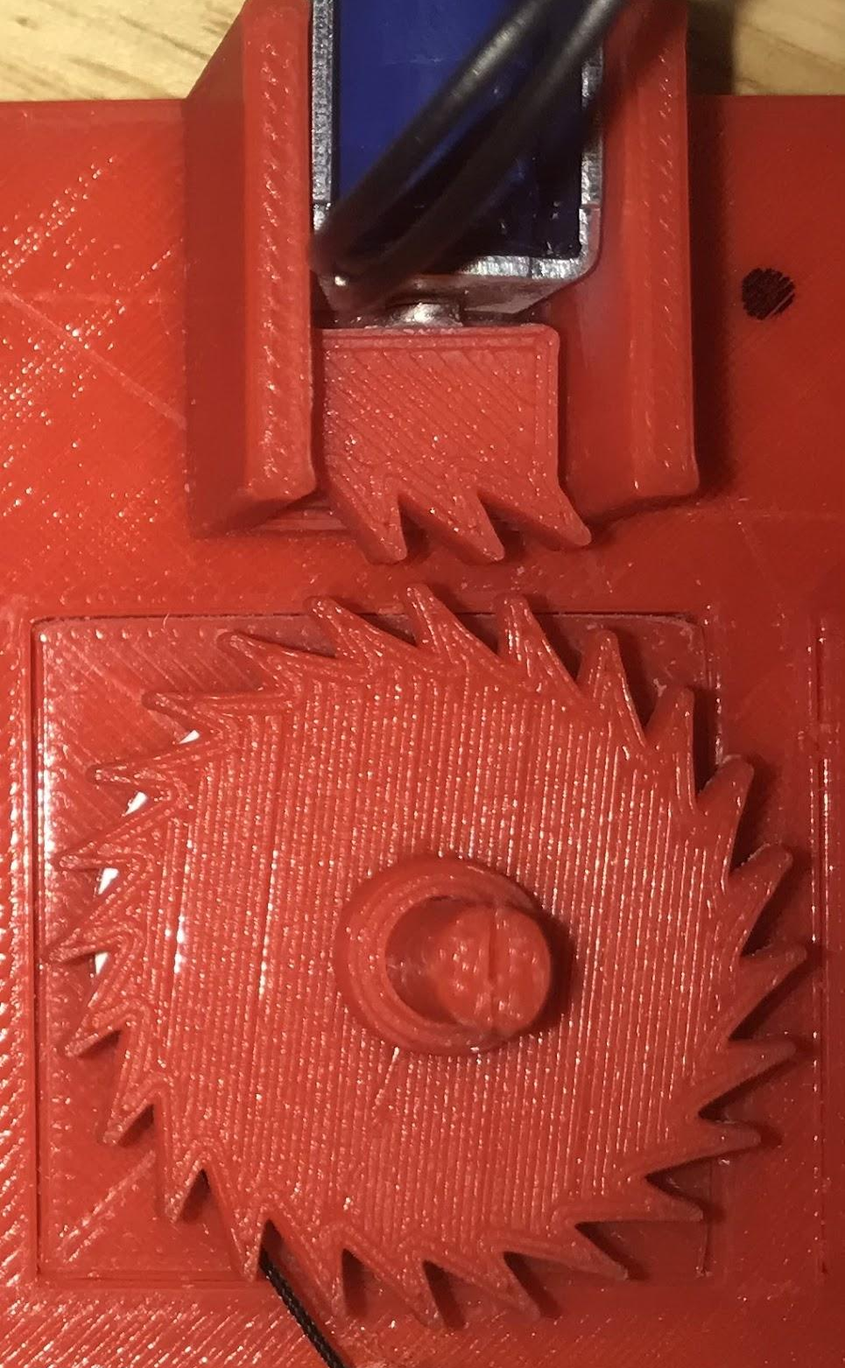
Jonathan Yip: 3D print and Arduino IDE
62mm x 184mm
Solenoids activate very briefly to save power
On/Off Solenoid
ERM intensity
Notes:
I was in charge of the 3D printing. I had to envision how the whole system looked in my head. I decided on having a rectangular platform that holds all of the ratchet and pawl systems. This housing would be mounted on the forearm. The dimensions of it currently are 62mm x 184mm. If i measure that up to my arm, the housing is a little wider than my arm but in terms of movement, our movement is not restricted. For the length, the housing is shorter than my forearm so it does not block any movement at the elbow.
In terms the print, we plan on the keeping pretty much the same for the final design. This is an ECE project so we dont want to focus too much on 3D printing. With that being said, we will need to tidy up our design and by adding routing canals for the strings and wires. You will see when we demo, the wires are a bit messy.
The housing consists of 5 sections which contains the ratchet and pawl system for each finger.
Since we want our design to be wireless, power is a main concern. Because of this we had to design our ratchet and pawl in a special way.
Here in the middle is a picture of one of the ratchet and pawl systems.
I will actually share my screen now to further explain how this ratchet and pawl works.
I was also in charge of writing the initial test code for system without BLE. I recieved the circuit diagram from anthony and constructed the circuit with one erm motoro and one solenoid I was able to activate the solenoid and control the ERM motor. Once I got that set up, I sent that to Alex, who repeated the design 5 times for the solenoid and 6 times for the ERM motors. One issue we ran into while runnning everything at once was that all the solenoids could not be activated at once. To combat this, we have a 10ms delay between the activation of each individual solenoid. This delay is not noticeable to the user.

Slide 18
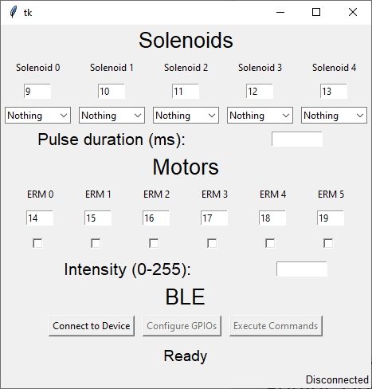
Cameron Kluza: BLE Communication
Simple protocol on top of BLE UART
Configure GPIO
Write GPIO
Pulse GPIO
PWM GPIO
MCU: Adafruit’s BLE UART service
Desktop: Python bleak library
Notes:
Cameron

Slide 19
Alex Dickopf : Prototyping
3-D printing parts to test and analyze
Putting all individual parts into one prototype
Combination of mechanical and circuit designs
Hand shapes to test (“dummy data”):
Pinch with finger and thumb
Individual fingers

Slide 20
MDR Accomplishments: Demo
Demonstration of Ratchet & Pawl on Arm

Slide 21
MDR Accomplishments: Demo
Pointer finger being stopped by stopper

Slide 22
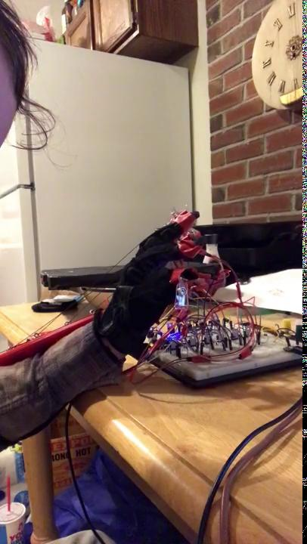
MDR Accomplishments: Demo
Hand Shape: Pinch with Pointer and Thumb

Slide 23
Plans for Next Semester
Remove development board and program nRF52840 with Bare Metal
Design and print custom PCB
Design simple demo in Unity to interact with objects in Virtual Reality
Use Vive Hand Tracking SDK to track hand and fingers
Communication between game, desktop, BLE, and MCU

Slide 24
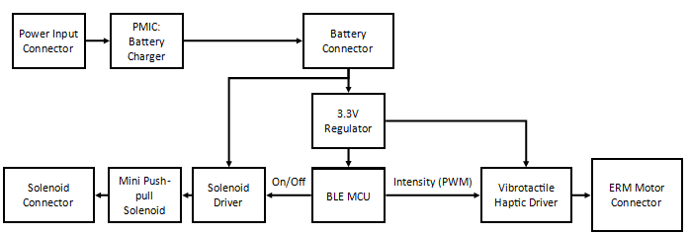
Hardware Plan for FPR
Custom PCB will closely follow glove half of hardware block diagram
Notes:
Cameron
Just verbally go through components that will be on the PCB

Slide 25
Current Hardware and Software
Hardware
Software
1 Adafruit Feather nRF52840 Express
1 nRF52840 module OR nRF52832
6 Sparkfun ERM motor
5 Adafruit Mini Push-Pull Solenoid 5V,1A
Transistors, resistors
Custom PCB
HTC Vive
Development environments
Arduino IDE
PyCharm (Python 3.8)
nRF52 Program
C/C++
Nordic SDK
Desktop VR App
Vive Hand Tracking SDK
Unity Game Engine
Notes:
Anthony

Slide 26
Project Expenditures
Total Shipping Cost for (all individual orders): $22.60
Total Cost: $176.34
Notes:
Alex

Slide 27
Project Expenditures: Projected Estimates
Custom PCB
JLCPCB lot of 5 50mm x 50mm 4-layer boards - $5
Major Parts (@ 5+ quantity)
Miscellaneous
Other PCB components (passives, FETs, diodes) - $30
Shipping - $20
Total: $90.50
Item | Individual Cost (@ qty 5) | Cost for 5
nRF52840 Module OR nRF52832 IC | $6 $2.82 | $30 $14.10
Charge PMIC | $0.60 | $3.00
Voltage Regulator | $0.50 | $2.50
Notes:
Alex

Slide 28
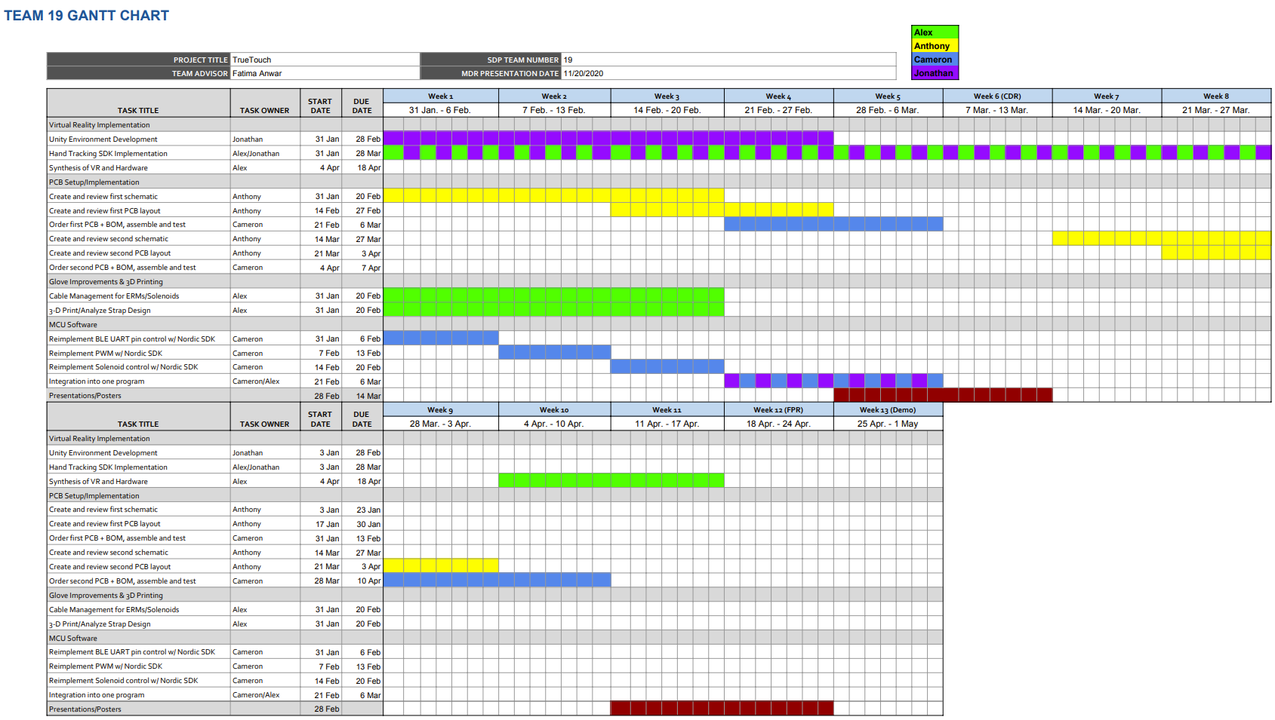
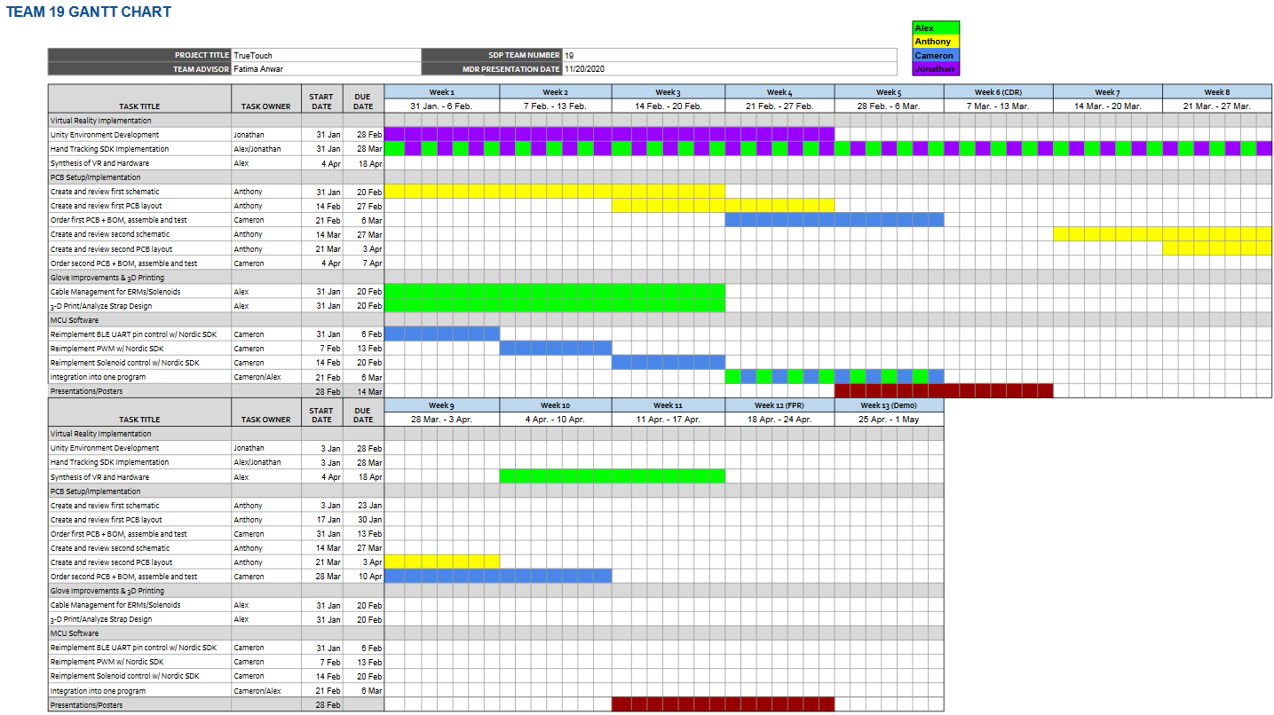
Gantt Chart
27
Notes:
Jonathan

Slide 29
Project Management - Additional Team Responsibilities
Team Coordinator: Anthony Chan
Altium Lead: Cameron Kluza
Budget Management Lead: Alexander Dickopf
Website Management: Jonathan Yip
Notes:
Jonathan

Slide 30
Thank you!
Questions?

